Slide 1

Manually Moving Turntables
7.10.24 version 1.0

Slide 2
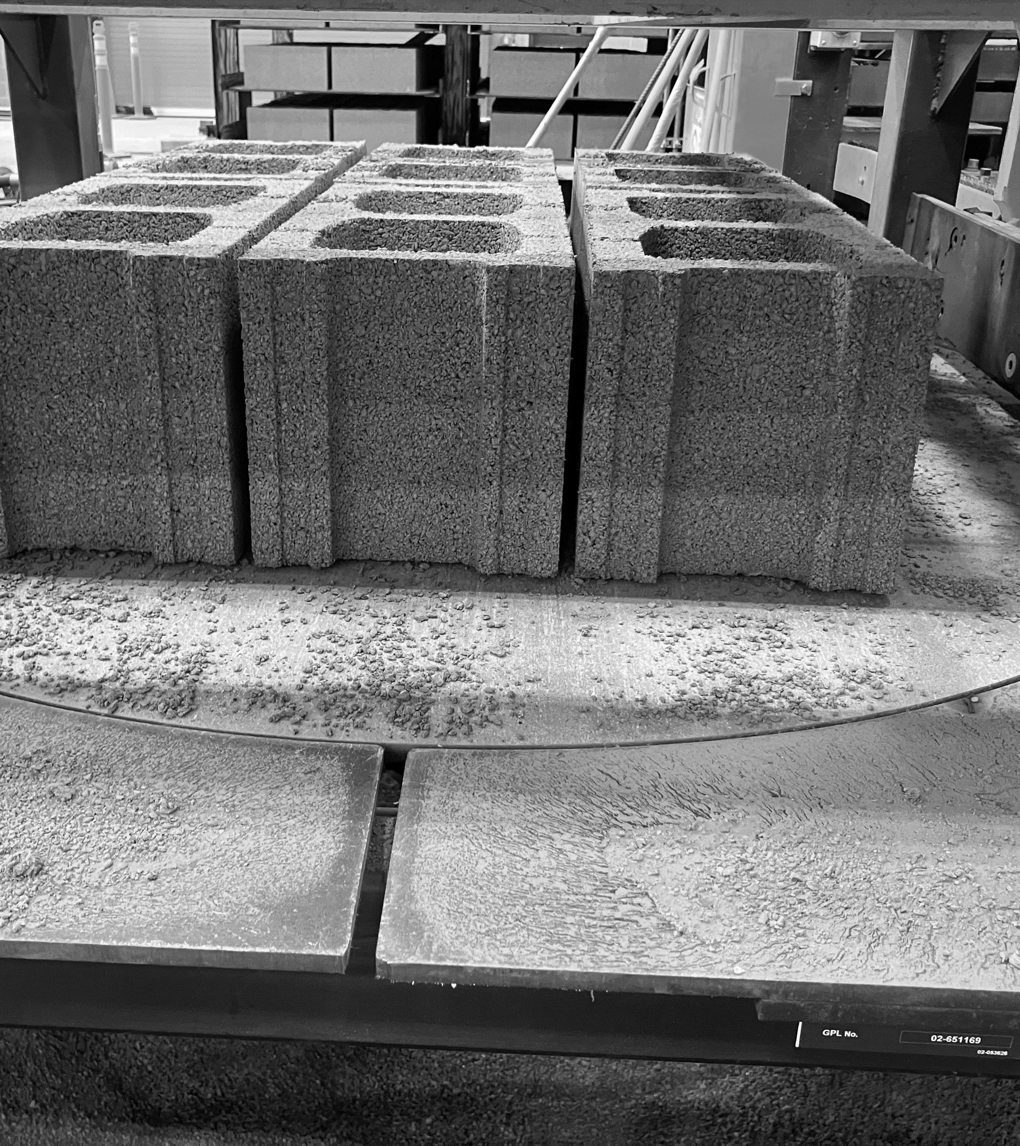
Assumptions and Prerequisite Skills
Machine is running
Supplies Needed
Standard PPE

Slide 3
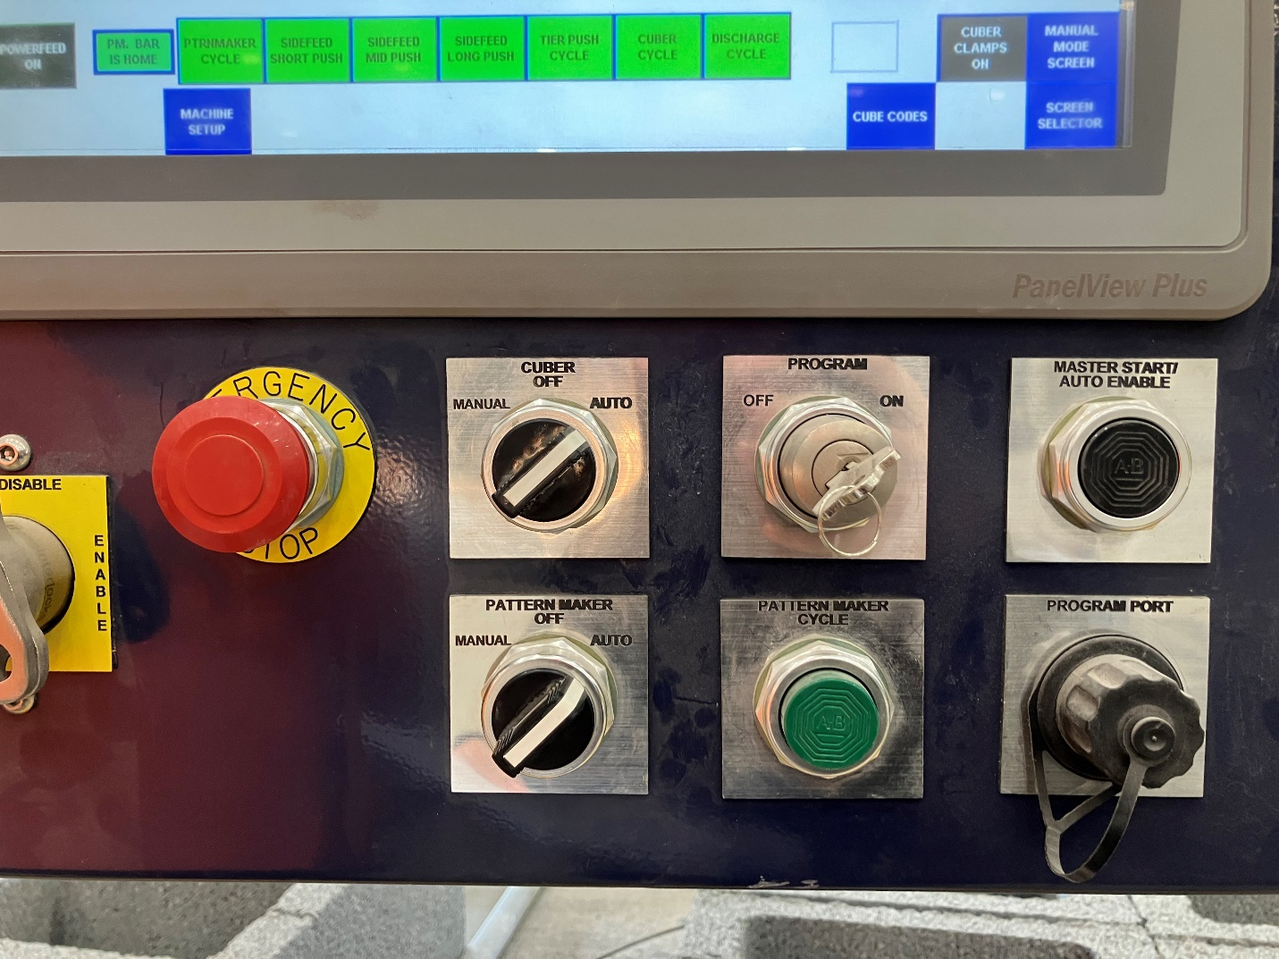
1. Wait until the “Mud Hopper” weight is approximately 0 before starting calculations.
2. Click on the “Auto Call” button under the Discharging 1 switch (Red circle, Figure 1). The button will then display as show in Figure 1.
Figure 1

Slide 4
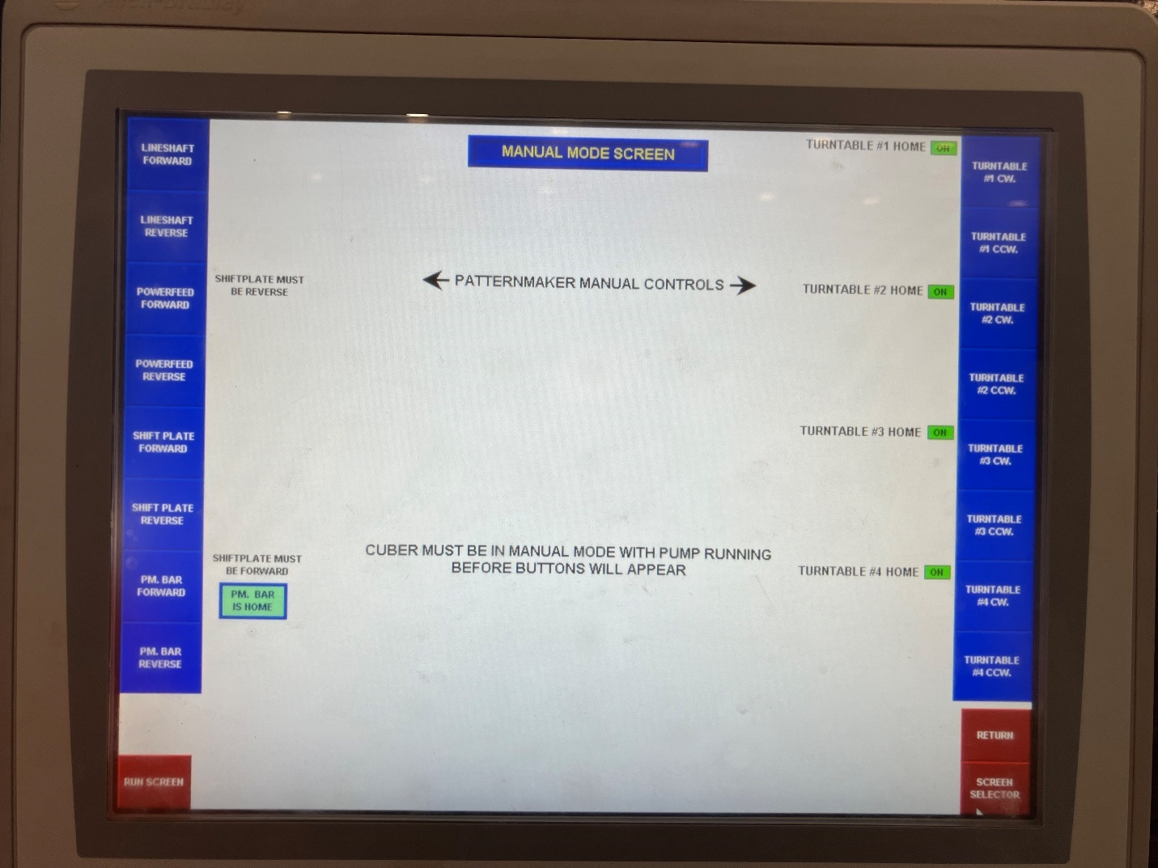
3. On the right side of the screen, choose the turn table you would like to adjust and use the buttons on the right side of the screen to readjust (Figure 2).
This completes the process.
Figure 2

